Slide 1
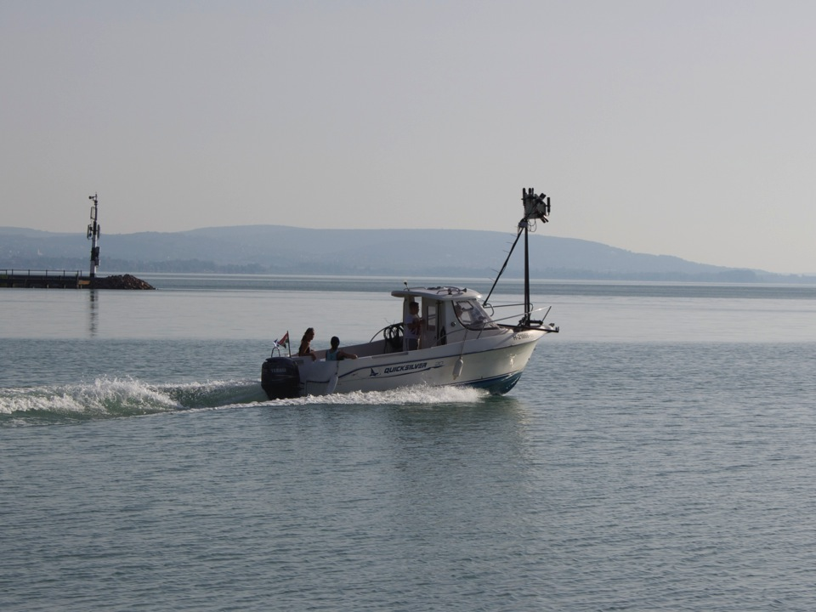







IOCCG-21 Committee Meeting
March 1-3 2016, Santa Monica USA
GloboLakes update: algorithm assessment across a range of optical water types
Global Observatory of Lake Responses to Environmental Change
Notes:
Good morning,
I would like to thank very much the organisers for inviting my group to give this talk in this influential event. And pass Andrew’s apologies for not being able to attend.
I want to use these 10 minutes to scratch actually the surface on EO uses and challenges for inland water quality giving a perspective of GloboLakes project and hopefully raise some discussion points.
GloboLakes is short for Global Observatory of Lake responses to Environmental Change and one of it’s aims to to develop an operational system for remote sensing of lakes. GloboLakes is a 5-year project wholly funded by the UK’s Natural Environment Research Council. It’s a consortium of researchers from 6 different UK university and research institutes and includes not only EO scientists – but also lake ecologists, ecosystem modellers and statisticians

Slide 2
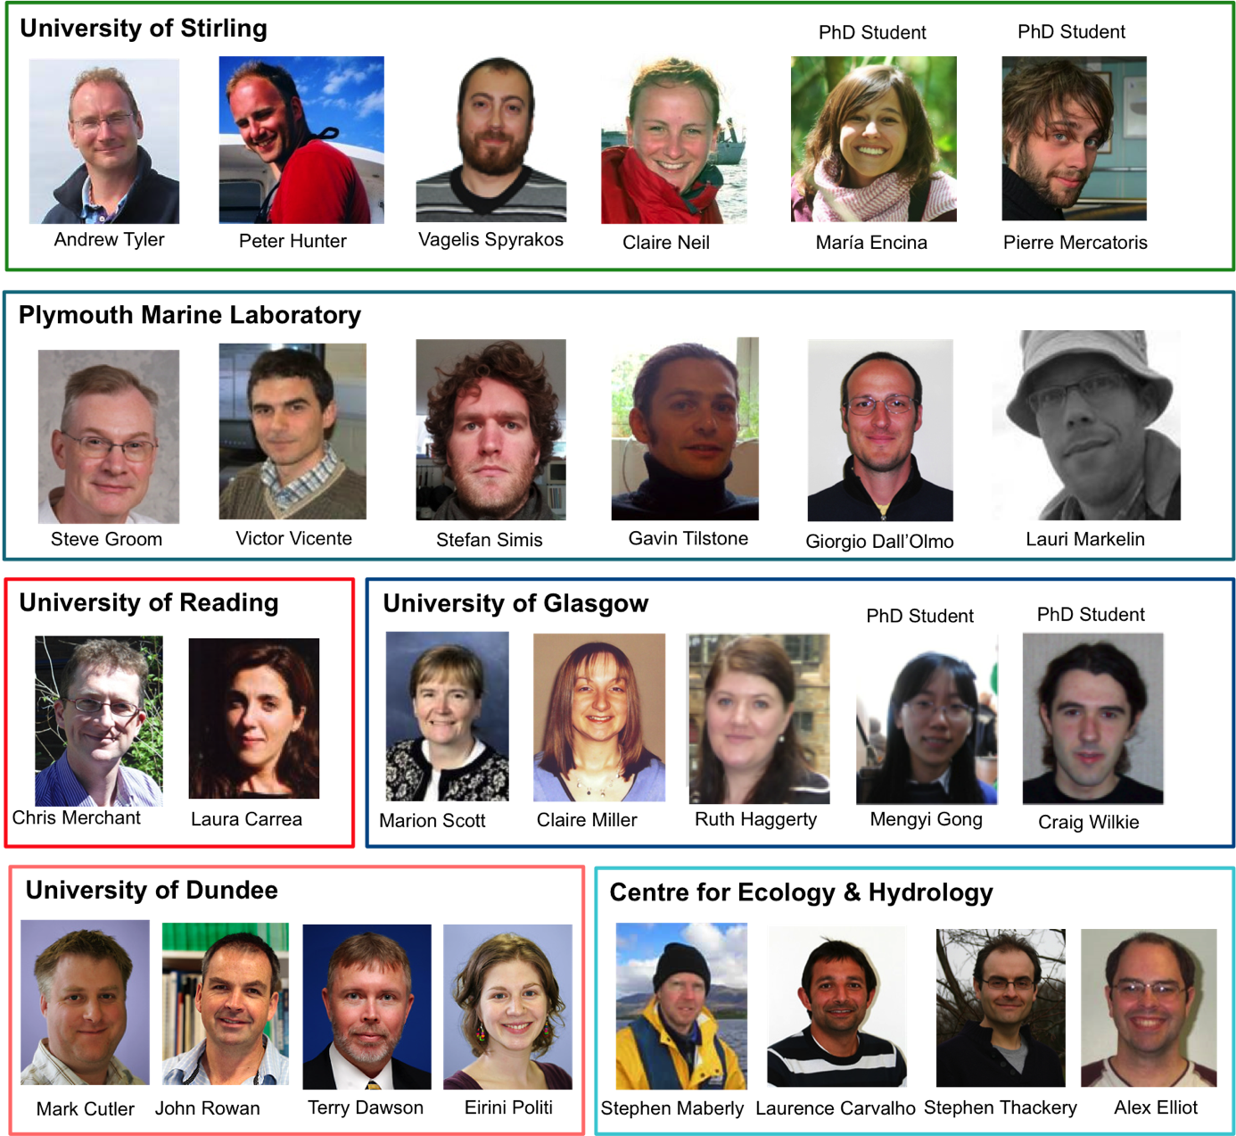
The Consortium
Six UK institutions
Earth observation
scientists
Environmental statisticians
Lake ecologists and modellers
IOCCG-21 Committee Meeting
Notes:
Good morning,
I would like to thank very much the organisers for inviting my group to give this talk in this influential event. And pass Andrew’s apologies for not being able to attend.
I want to use these 10 minutes to scratch actually the surface on EO uses and challenges for inland water quality giving a perspective of GloboLakes project and hopefully raise some discussion points.
GloboLakes is short for Global Observatory of Lake responses to Environmental Change and one of it’s aims to to develop an operational system for remote sensing of lakes. GloboLakes is a 5-year project wholly funded by the UK’s Natural Environment Research Council. It’s a consortium of researchers from 6 different UK university and research institutes and includes not only EO scientists – but also lake ecologists, ecosystem modellers and statisticians

Slide 3
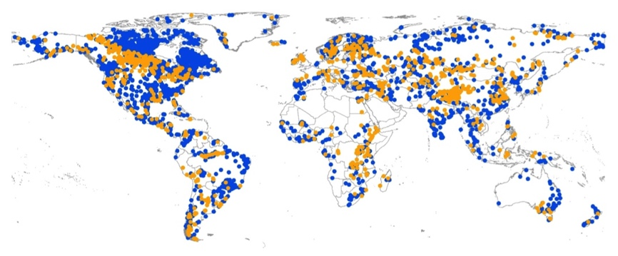
Introduction
Global observatory of lake responses to environmental change (GloboLakes)
Water quality and temperature products for 1000 lakes globally;
High diversity in lake optical properties;
No single in-water algorithm will have global applicability;
Need approach for dynamic selection of in-water algorithms.
Study lakes
GLWD Level-1 (3,721)
GloboLakes (~1,000)
IOCCG-21 Committee Meeting

Slide 4
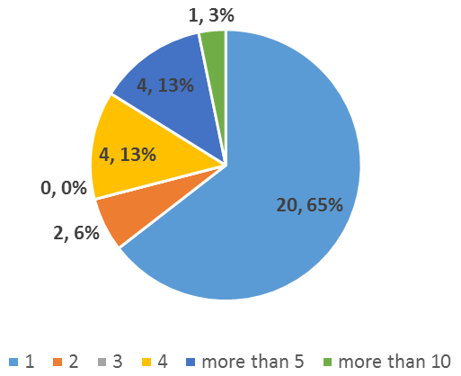
EO Challenges
EO key challenges:
Diversity in retrieval algorithms & validation approaches
Inland water remote sensing community appears fragmented
Number of lakes per publication:
Search Keys: remote sensing, water quality, lakes (2015)
Filter: use of in-situ data for development/validation
IOCCG-21 Committee Meeting

Slide 5
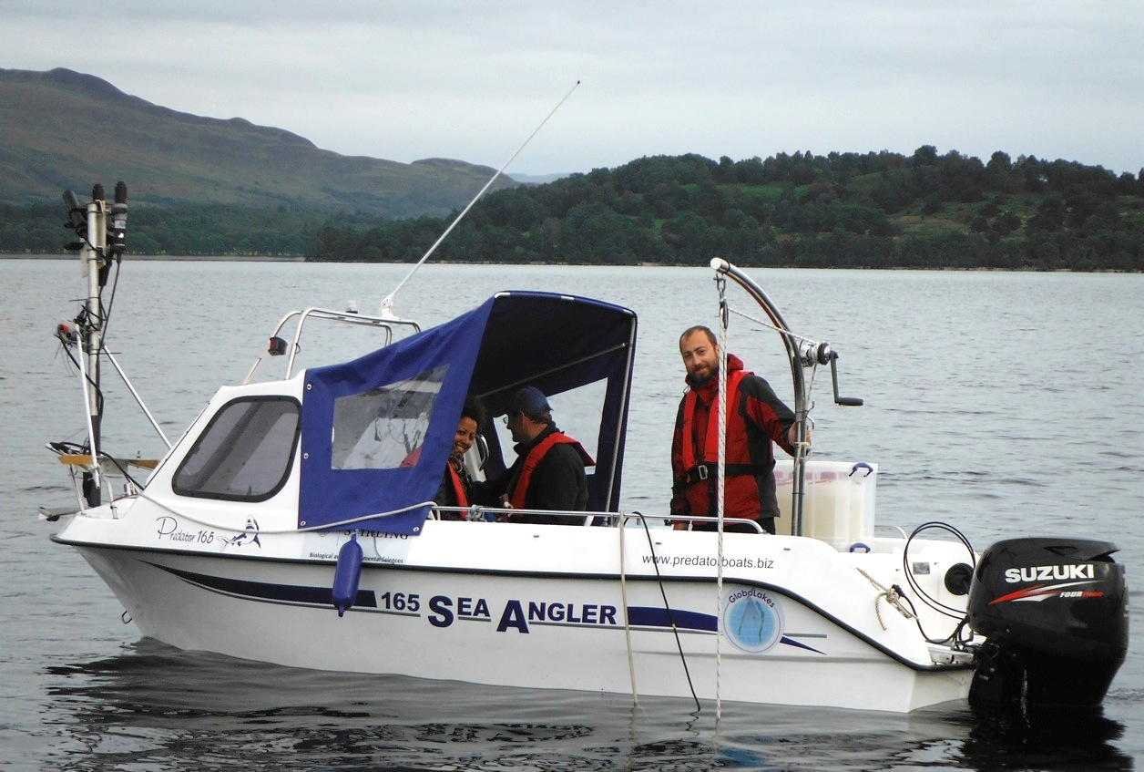
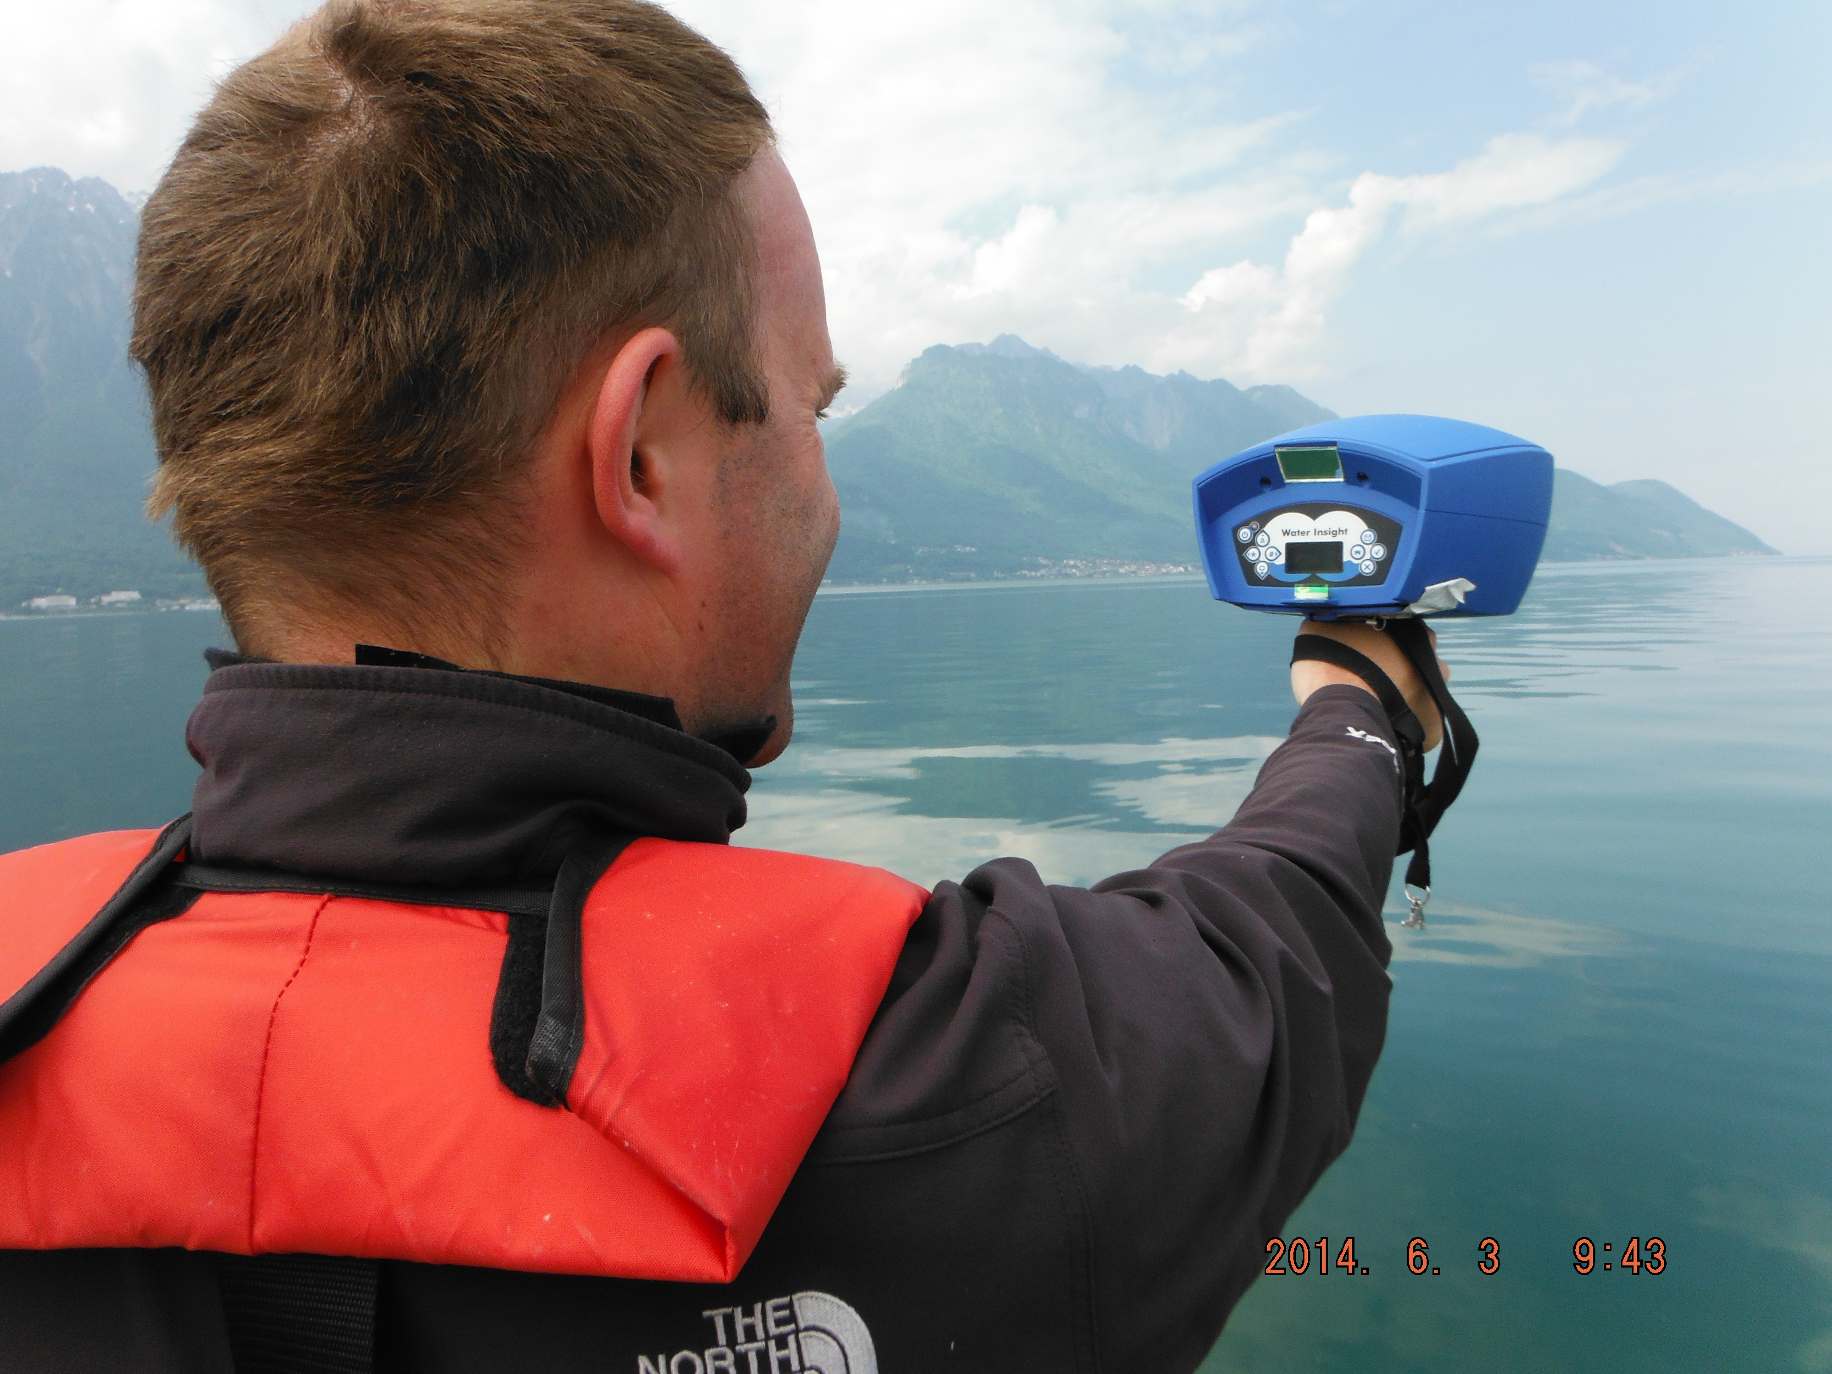
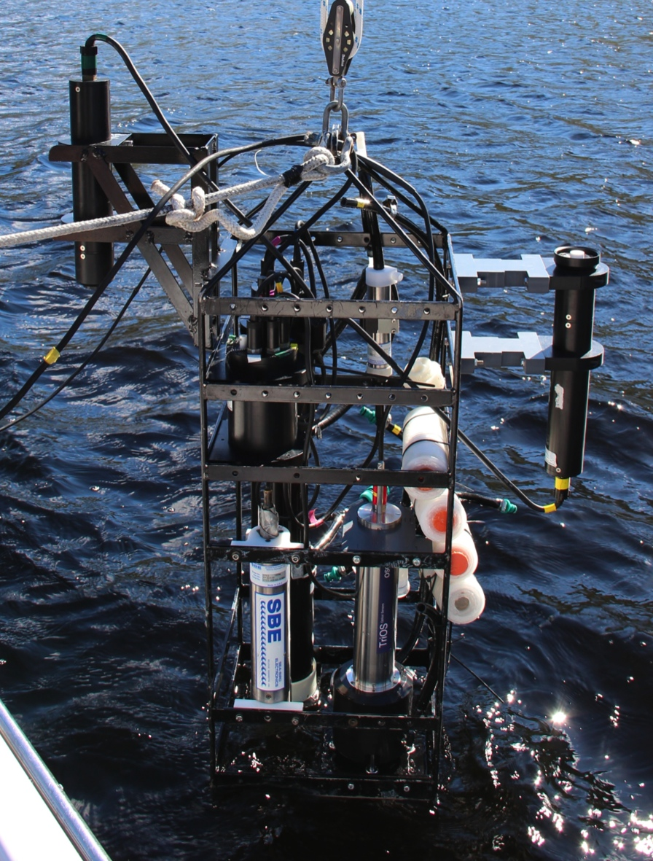
Cal/Val Activities
Inter-comparison of biogeochemical algorithms for ensemble in-water model
Research campaigns on UK and European lakes
Space and time variability in optical properties
Data to support validation of in-water models for parameter retrieval
  300 stations on 18 lakes
  S2/S3 validation 2015 onwards
IOCCG-21 Committee Meeting
Notes:
Good morning,
I would like to thank very much the organisers for inviting my group to give this talk in this influential event. And pass Andrew’s apologies for not being able to attend.
I want to use these 10 minutes to scratch actually the surface on EO uses and challenges for inland water quality giving a perspective of GloboLakes project and hopefully raise some discussion points.
GloboLakes is short for Global Observatory of Lake responses to Environmental Change and one of it’s aims to to develop an operational system for remote sensing of lakes. GloboLakes is a 5-year project wholly funded by the UK’s Natural Environment Research Council. It’s a consortium of researchers from 6 different UK university and research institutes and includes not only EO scientists – but also lake ecologists, ecosystem modellers and statisticians

Slide 6
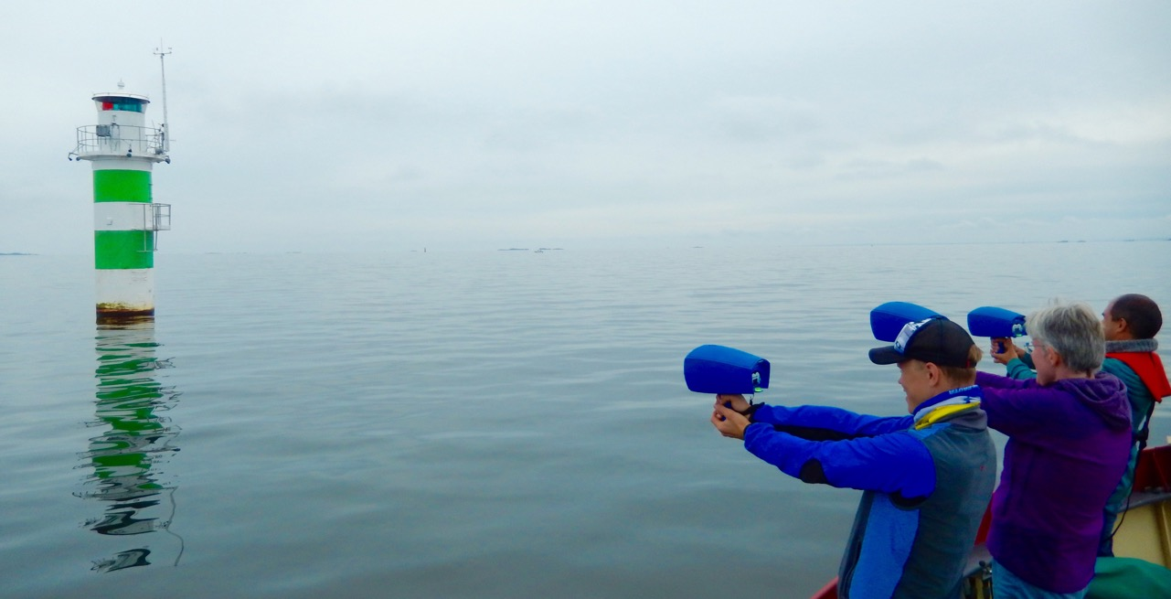
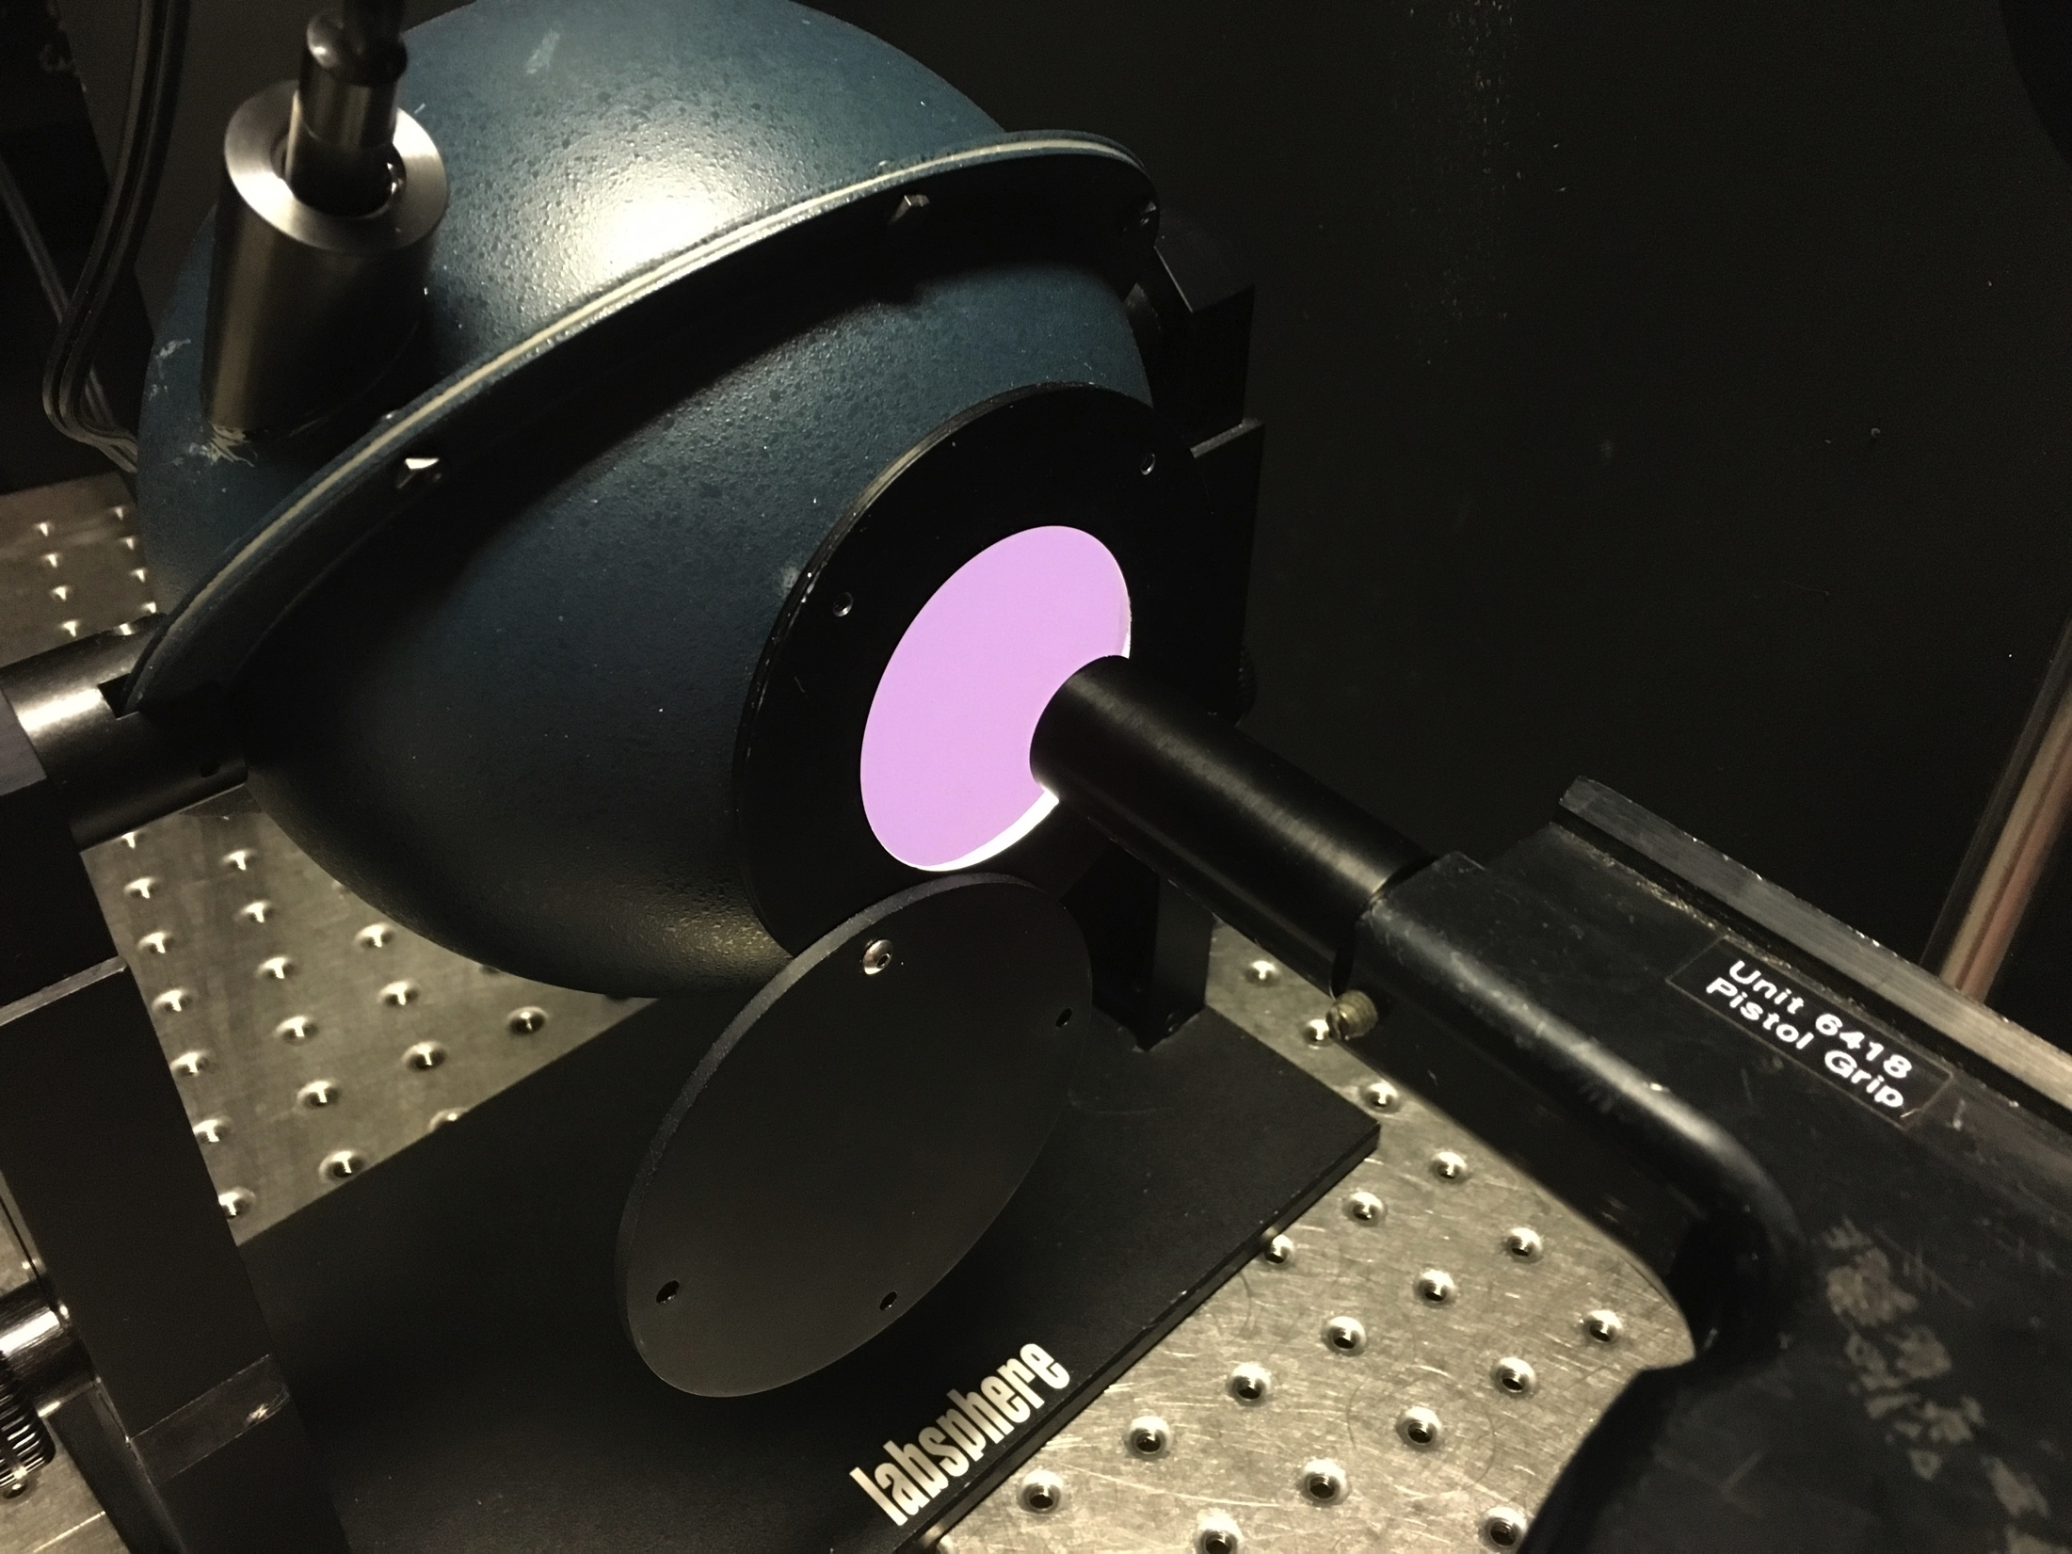
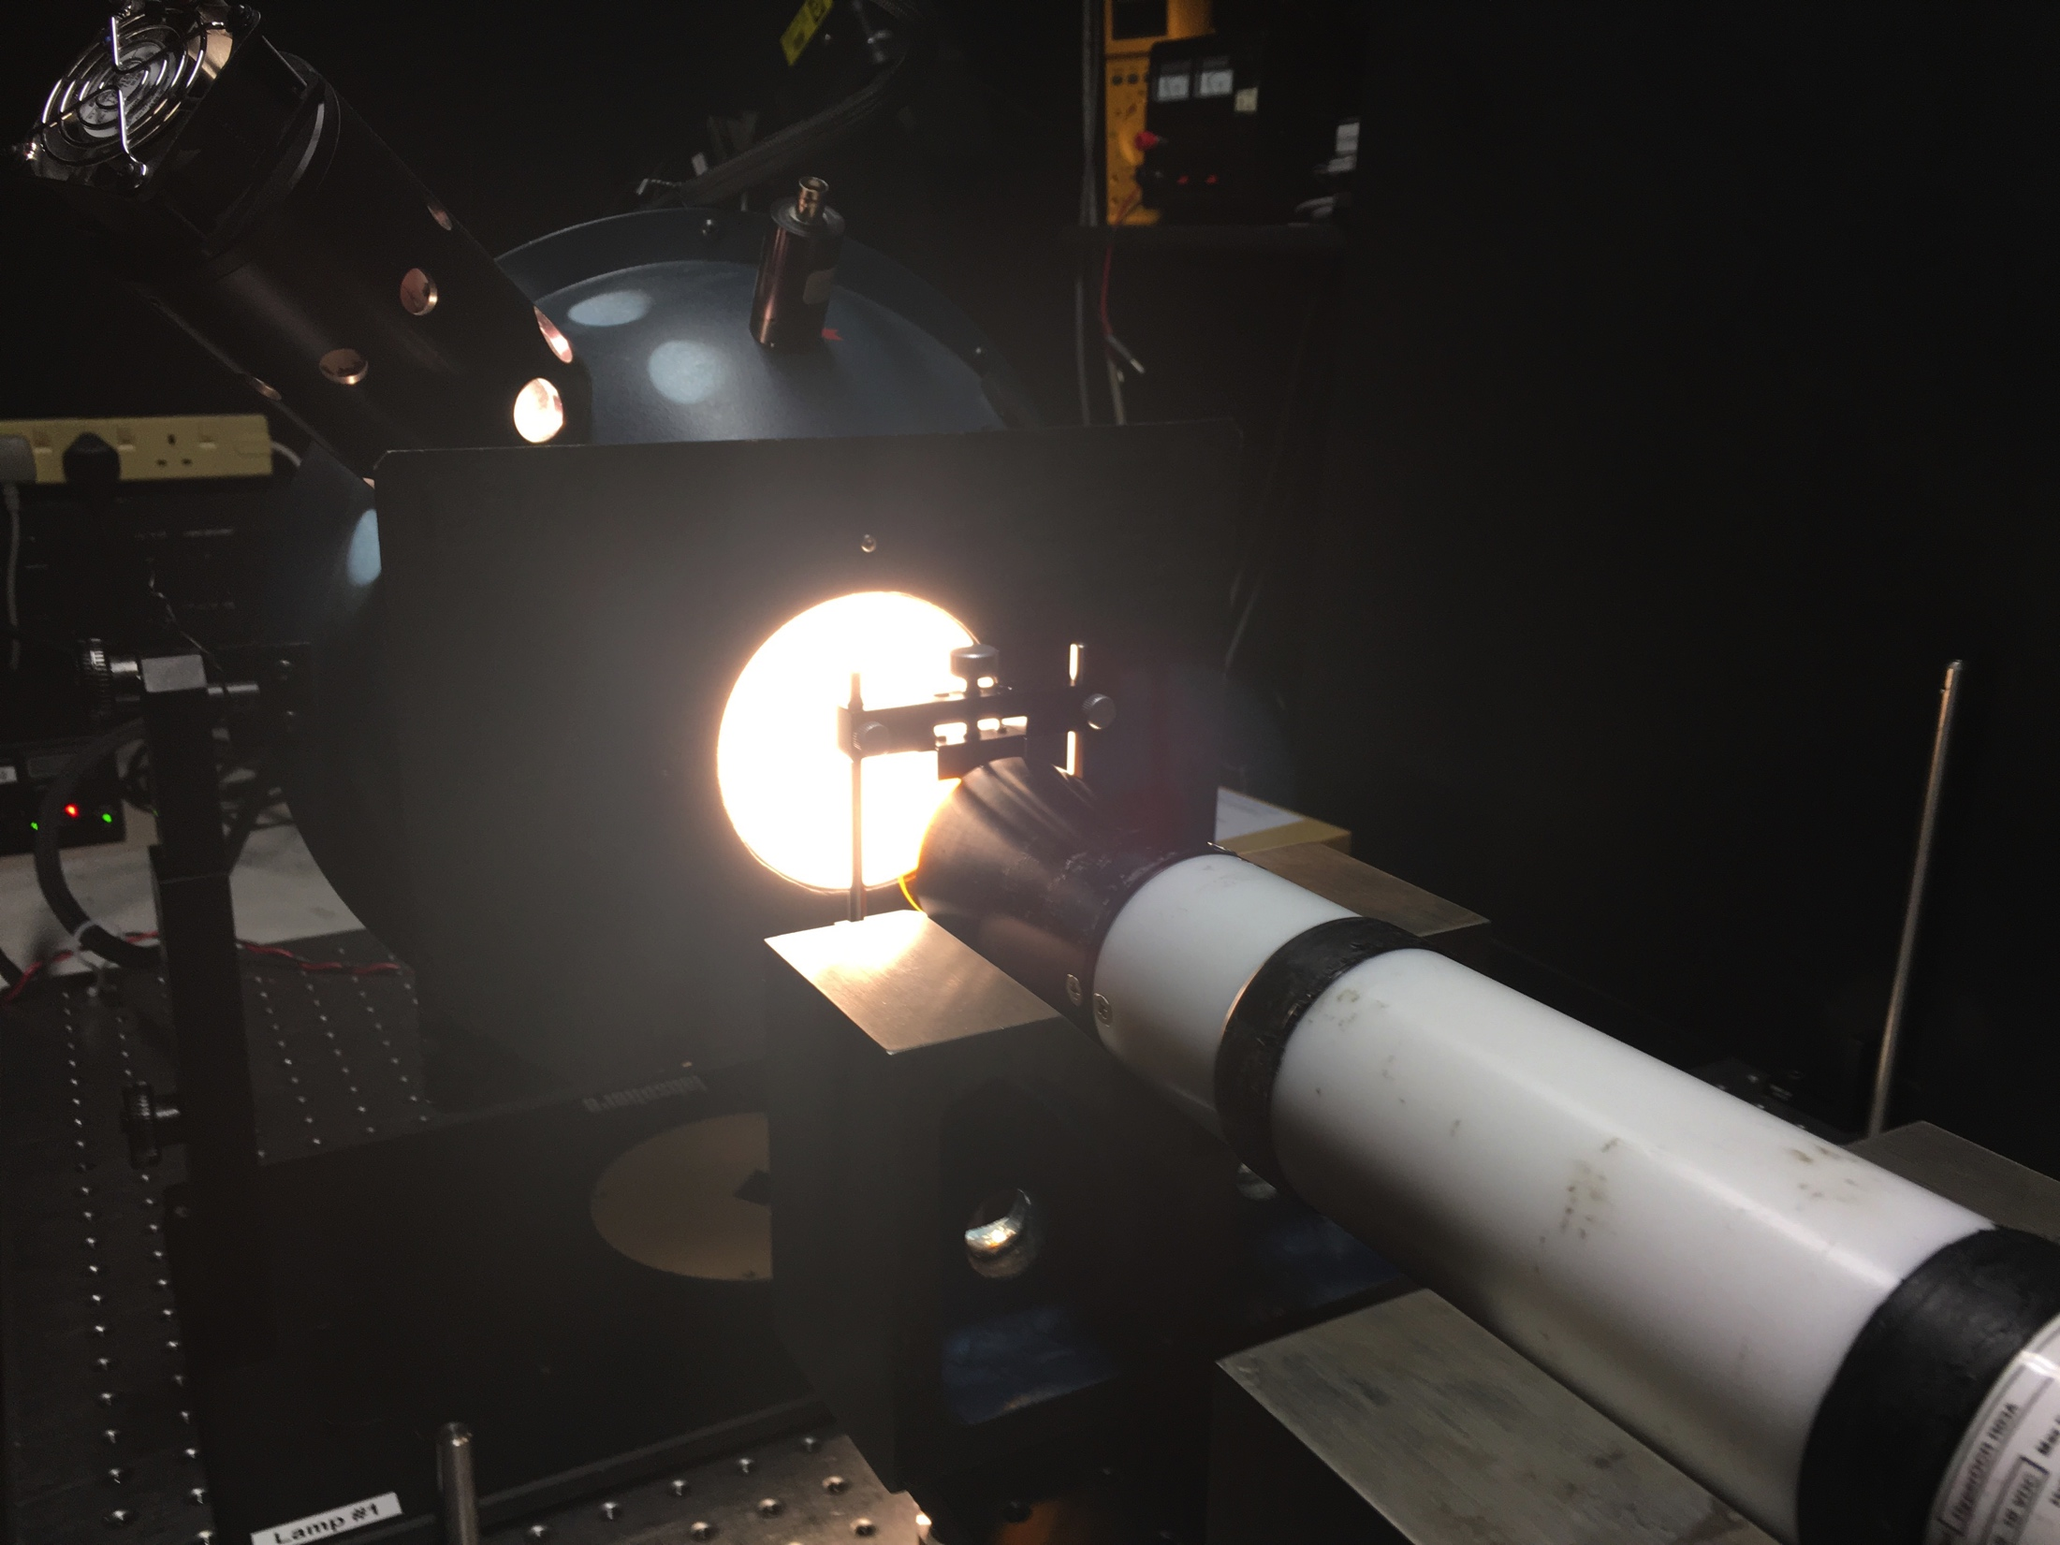
In-situ and laboratory intercomparison
NERC INCIS-3IVE project
USTIR, PML, Tartu Observatory, Water Insight and Stockholm University
Inter-comparison of in situ radiometric measurements
Effect of instruments (incl. calibration), methods and protocols on data comparability
Hosted by NERC Field Spectroscopy Facility
  Satlantic HyperSAS
  TriOS RAMSES
  WISP-3 (x1)
  ASD FieldSpec
Wavelength & radiometric calibrations plus stray light characterisation
IOCCG-21 Committee Meeting

Slide 7

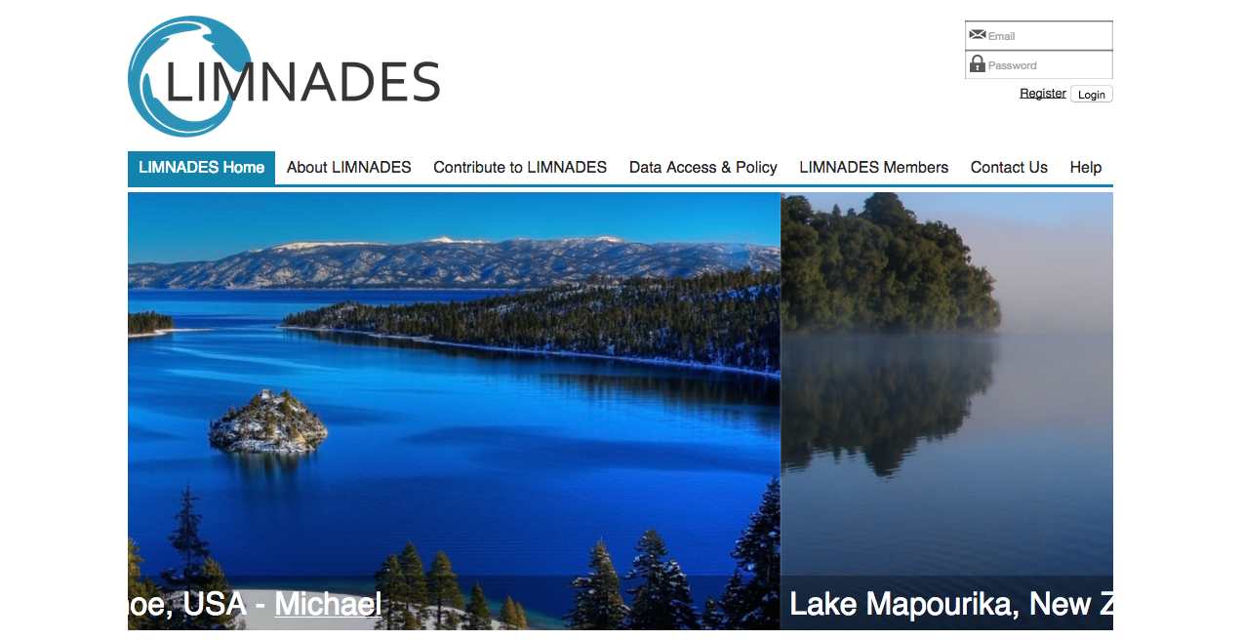
LIMNADES
  Data from almost 1500 lakes
  Radiometric data from ~4000 stations on >250 lakes
  At least 40 peer-reviewed papers
  ~1000 stations with in situ IOP data spectra
  2221 stations with a_{cdom}(442)
IOCCG-21 Committee Meeting

Slide 8
LIMNADES: The Data
R_{rs}(λ) = 3025 spectra 1-nm interval
from 400-800 nm
IOCCG-21 Committee Meeting

Slide 9
Clustering methods
0 or 1
Model-based
Cluster membership
Statistically optimal n.c
K-means
cluster membership
Reference distribution
0 or 1
fuzzy c-means
partial membership
[0, 1]
Validity indices
bagged FCM
Bayesian clustering
[0, 1]
Hierarchical
Rand index>0.75
IOCCG-21 Committee Meeting

Slide 10
Clustering Results
IOCCG-21 Committee Meeting

Slide 11
Clustering Results
Cluster 1
Cluster2
Cluster3
Cluster4
Cluster5
Cluster6
Cluster7
Cluster8
Cluster9
Cluster10
Cluster11
Cluster12
Cluster13
Very high PC (scum)
Dominance of Pigments + ACDOM over ISM
Clear waters
CHLA+PC+SPM+ACDOM moderate
Very high SPM
Very high SPM + CHLA + ACDOM
Very high Chla + PC
High Chla + PC
Chla +PC+SPM+ACDOM low
Very high CDOM + ISM
Low aPH* / High aNAP* + CDOM
Moderate CHLA + PC High SPM
Very clear waters
IOCCG-21 Committee Meeting

Slide 12
Validation Procedure
Step 1: Validation of original algorithms
Test existing algorithms using in-situ data.
Step 2: Retuning per cluster
Retune using LIMNADES in-situ dataset.
Step 3: Dynamic algorithm selection
Determine top performing algorithms per cluster.
IOCCG-21 Committee Meeting

Slide 13
Algorithms Tested
Constituent | Type | Model | Reference
Chlorophyll | Empirical NIR-red BR | MERIS 2-Band 708/665 | Gilerson et al., 2010, Gurlin et al., 2011, Gons et al., 2005.
 |  | MERIS 2-Band 753/665 | Gilerson et al., 2010, Gitelson et al., 2011, Moses et al., 2009.
 |  | MERIS 3-Band | Gitelson et al. 2008, Gitelson et al. 2011, Gurlin et al., 2011, Moses et al., 2009.
 |  | MERIS NDCI | Mishra et al. 2012.
 | Empirical OC | MERIS OC2E MERIS OC3E MERIS OC4E | O’Reilly et al. 2000.
 | Neural Network | NN_Chl NN_IOP | Ioannou et al., 2013.
 | Analytical | MERIS QAA [Turbid] | Mishra et al., 2013.
 |  | MERIS GSM | Maritorena et al., 2002.
 |  | MERIS Matrix Inversion | Boss & Roesler, 2006.
 | Peak Height Method | MPH | Matthews et al., 2012.
Constituent | Type | Model | Reference
Suspended Particulate Matter | Empirical | Binding red Zhang 708 Vantrepotte 665 POWERS 560 | Binding et al., 2006, Zhang et al., 2010, Vantrepotte et al., 2011, Eleveld et al., 2008.
 |  | D’Sa 665/560 Dekker 490,560 Dekker 560,665 | D’Sa et l., 2007, Dekker et al., 2002.
 |  | Loisel 3-Band | Loisel et al., 2014.
 | Analytical | Binding A Nechad 665 Nechad 681 Nechad 708 Nechad 753 | Binding et al., 2010, Nechad et al., 2010.
Constituent | Type | Model | Reference
Phycocyanin | Empirical | Duan 709/620 | Duan et al., 2012.
 |  | Duan 3-Band Song 3-Band | Duan et al., 2012, Song et al., 2013.
 | Analytical | Mishra QAA 13 Mishra QAA 14 Simis | Mishra et al., 2013, Mishra et al., 2014, Simis et al., 2005.
IOCCG-21 Committee Meeting

Slide 14
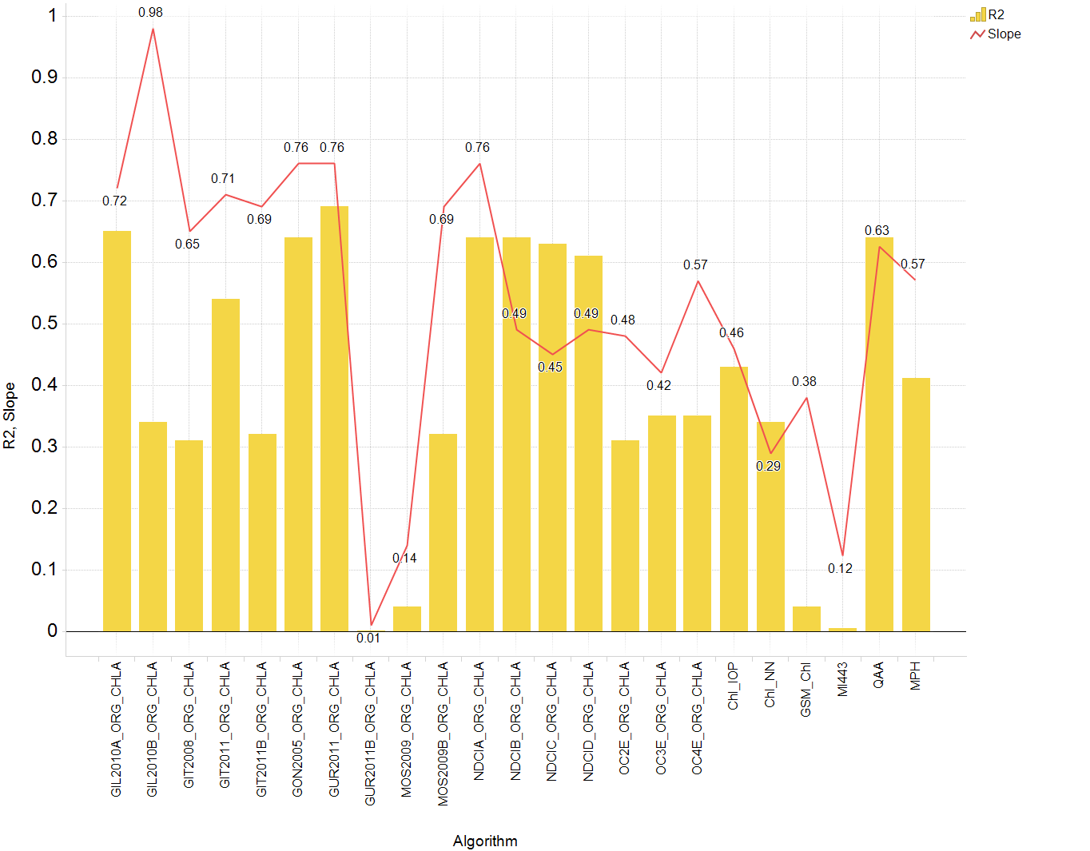
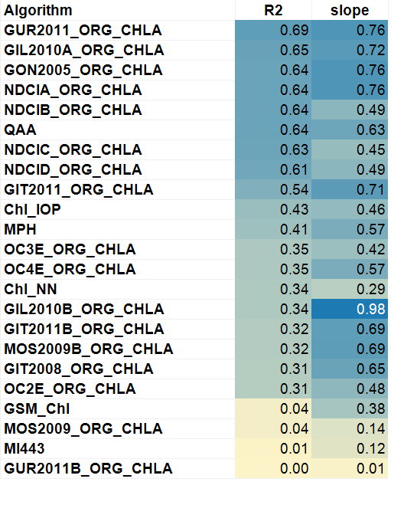
Results from un-tuned algorithms: Step 1
NN
ALY
NIR-red BR
OC
MPH
IOCCG-21 Committee Meeting

Slide 15
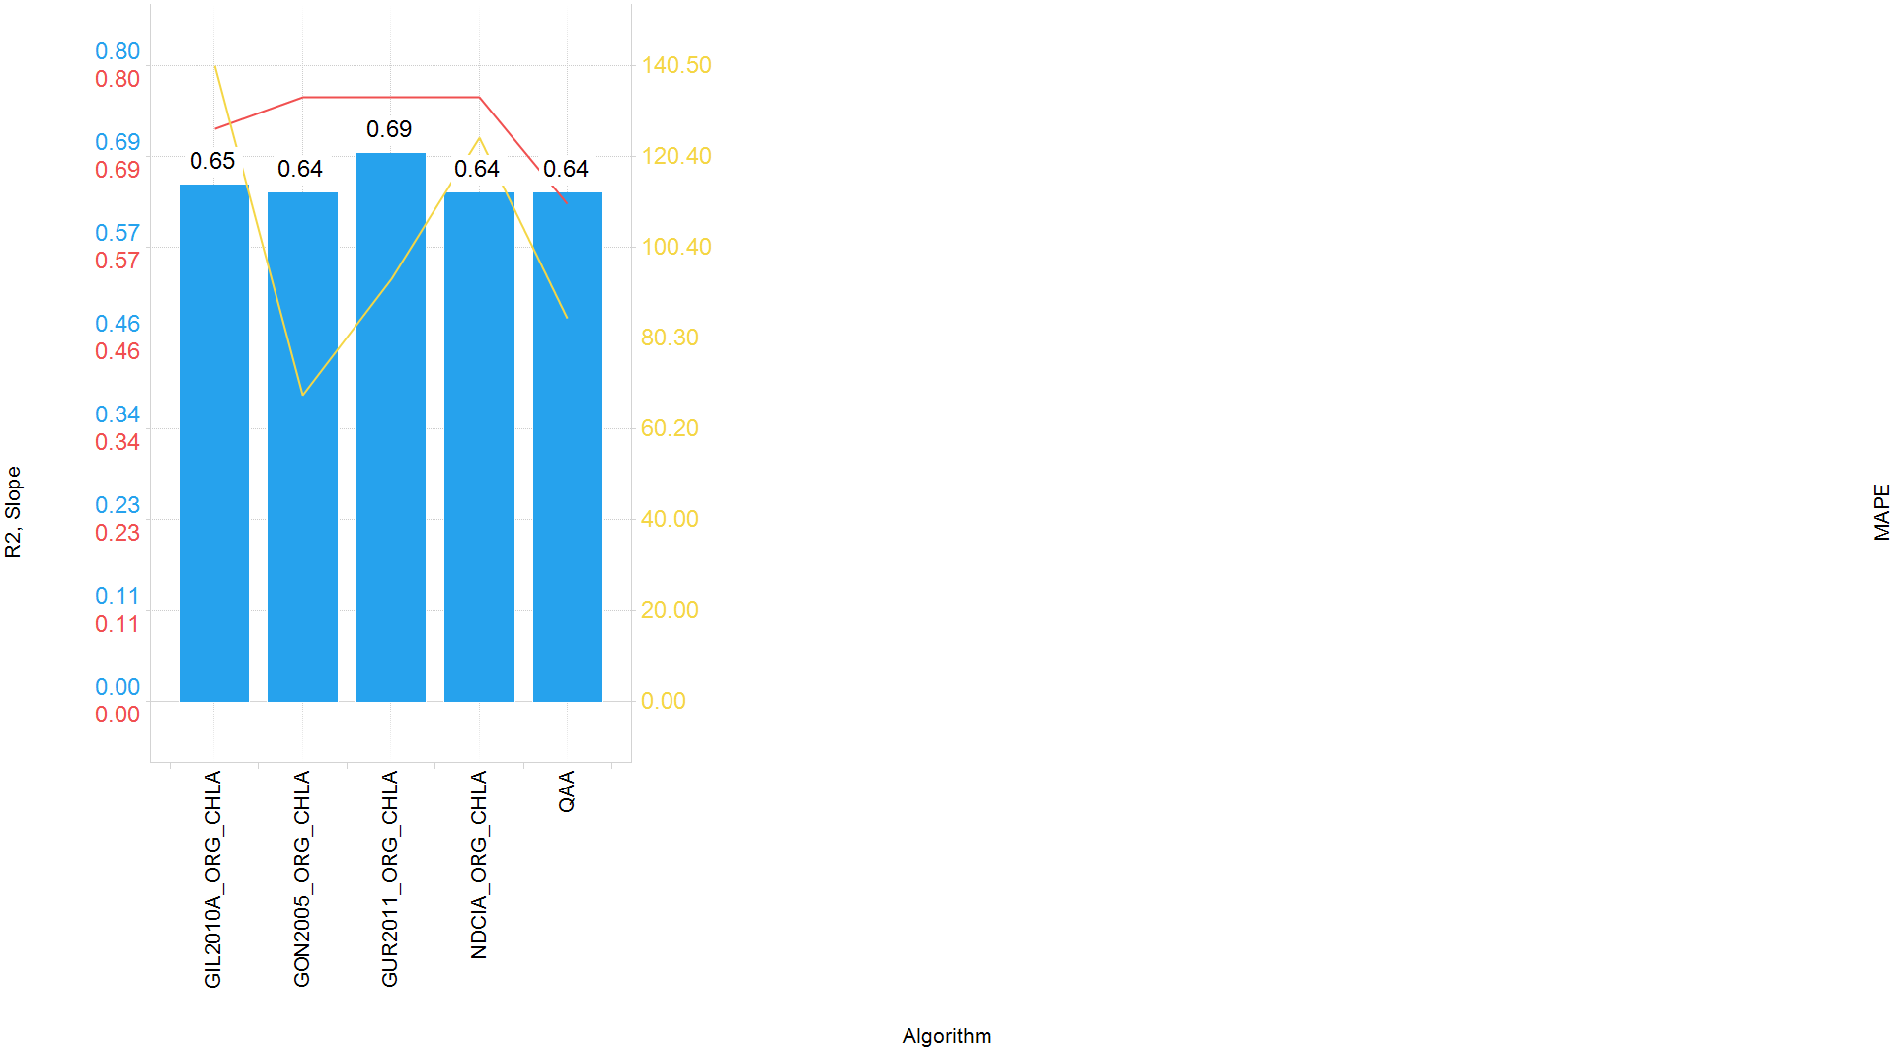
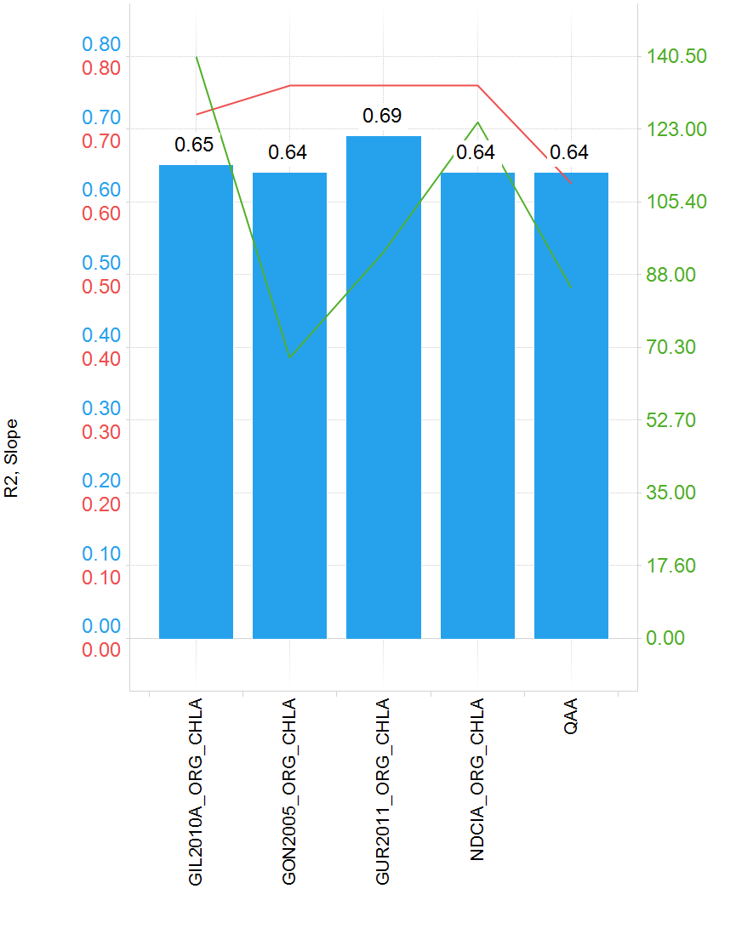
Top Performing Algorithms
Only 5 of the algorithms tested predicted chl within an acceptable error budget (R² > than 0.6 and 0.6<slope<1.4).
Of these, 4 were based on the reflectance ratio 708/665.
All 4 algorithms based on reflectance ratio 708/665 performed well.
Gurling 2011 was shown to produced the most satisfactory results over the full LIMNADES dataset.
IOCCG-21 Committee Meeting

Slide 16
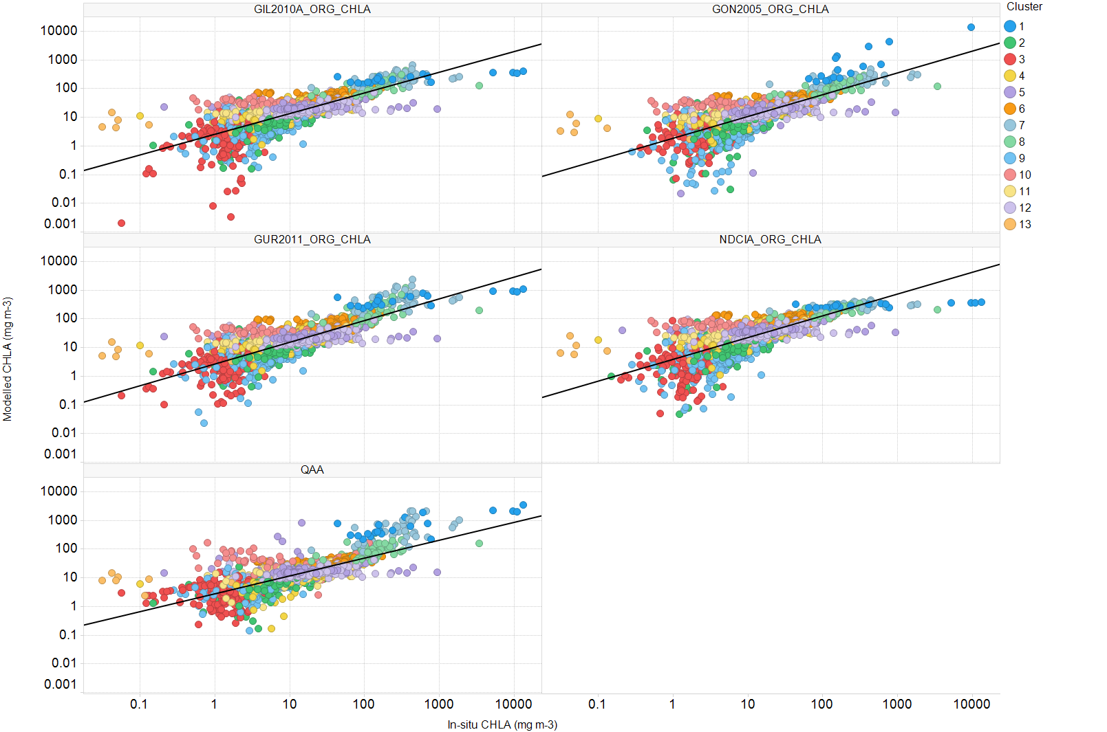
Cluster Pattern for Modelled vs Measured Chl a
IOCCG-21 Committee Meeting

Slide 17
Reparameterising using LIMNADES: Step 2
Algorithms were reparameterised using the LIMNADES dataset.
Model coefficients were determined for each individual cluster.
IOCCG-21 Committee Meeting
Notes:
Reparameterised each the ratios within each cluster. For the semi analytical we chose the phytoplankton absorption for each cluster.

Slide 18
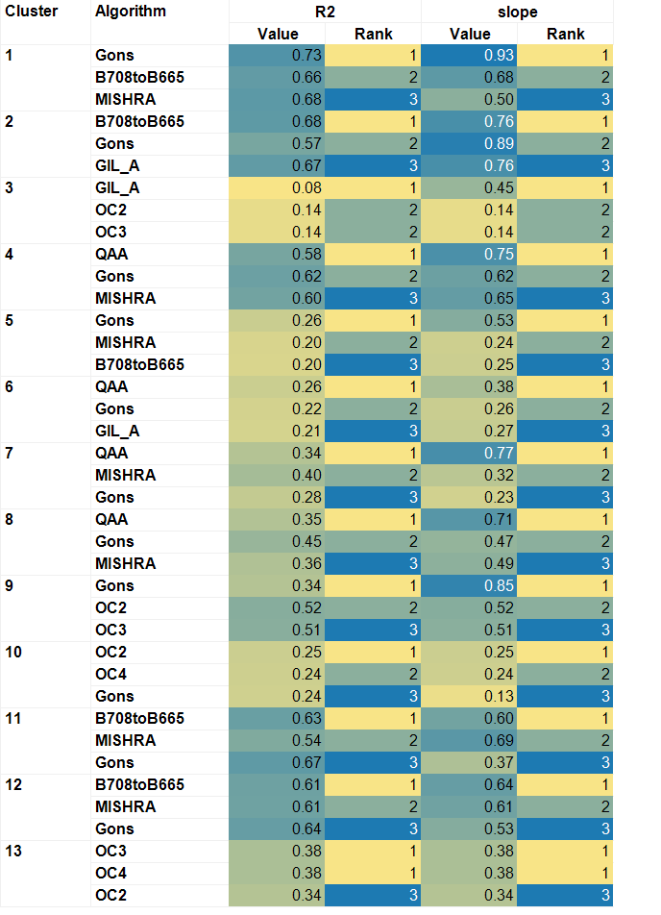
Top performing algorithms for dynamic selection: Step 3
Some algorithms performed well in several clusters (Gons, B708toB665, QAA).
The band ratio 708/665 variable was still the optimal parameter when considering individual clusters (with Gons and Gilerson modifications).
Some clusters were poorly represented by the tested algorithms.
Six different algorithms were highlighted as the best performers in the 13 clusters.
IOCCG-21 Committee Meeting
Notes:
These are not the only performance stats used – using 10 criteria (Brewing) in total which include MAPE RMSE etc.

Slide 19
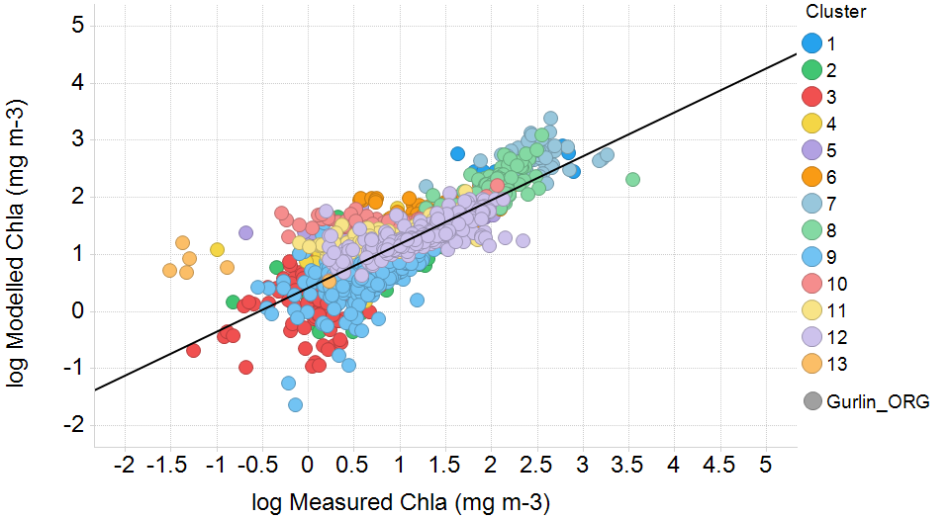
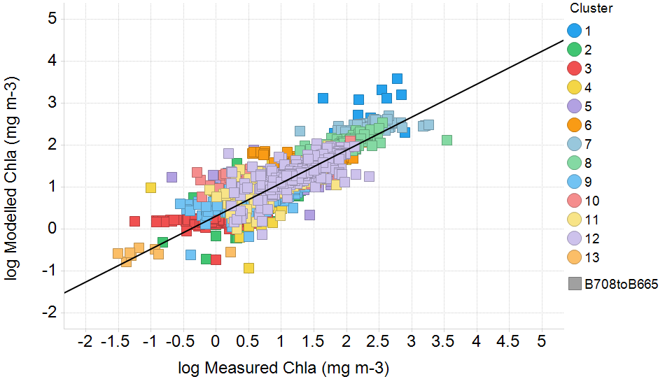
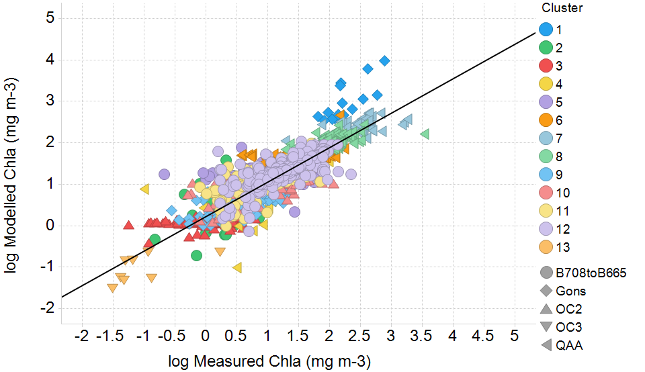
Validation results: three steps
Gurlin 2011 original output
Band ratio 708/665 retuned per cluster
Y=0.7692x + 0.4175
R²=0.698
MAPE=164.5
Y=0.7863x + 0.311
R²=0.7891
MAPE=84.67
Retuning per cluster produces more accurate results than a standard algorithm.
Further improvements are evident when using the best performing algorithm per cluster.
Dynamic algorithm selection per cluster
Y=0.8313x + 0.2197
R²=0.7969
MAPE=92.96
IOCCG-21 Committee Meeting

Slide 20
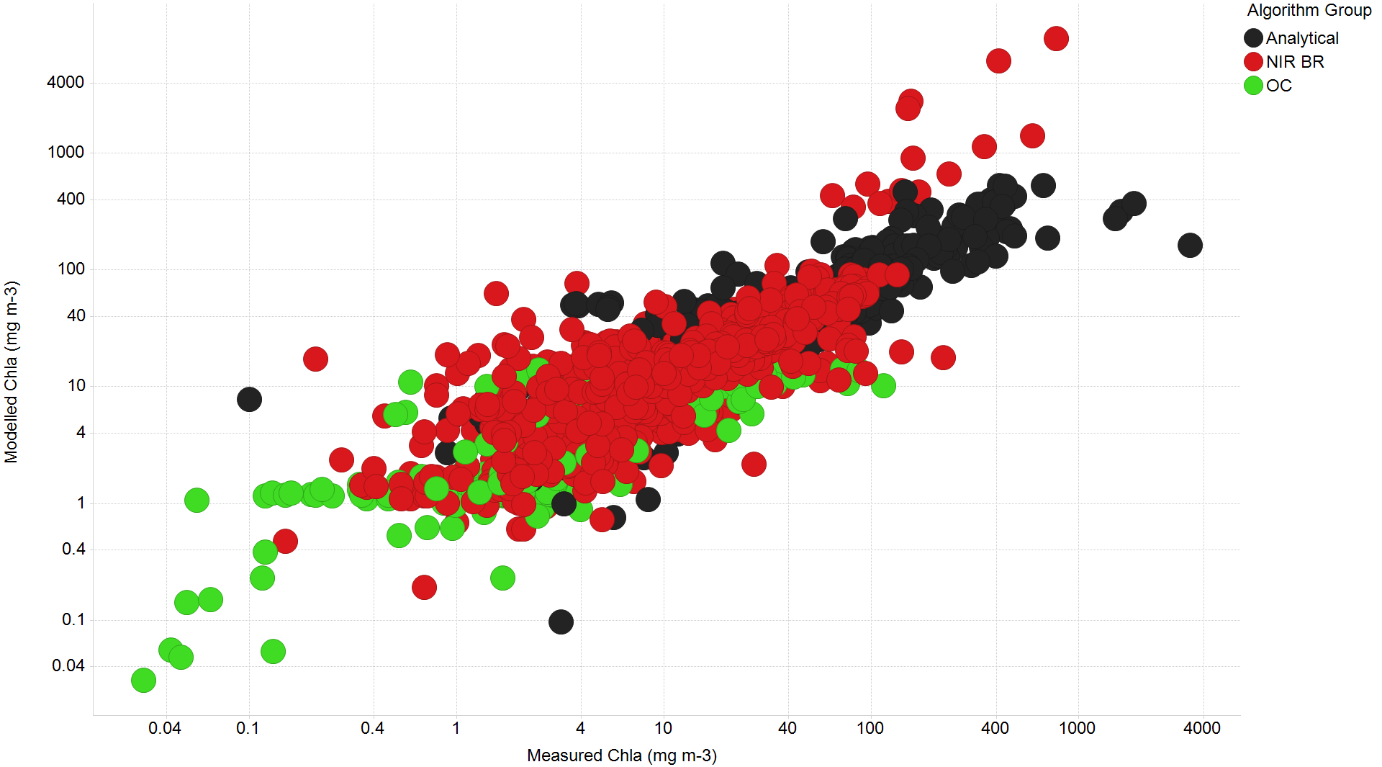
Clustering of algorithm groups
IOCCG-21 Committee Meeting
Notes:
Link with Vagelis’ paper slide –algorithms perform in specific chl a ranges

Slide 21
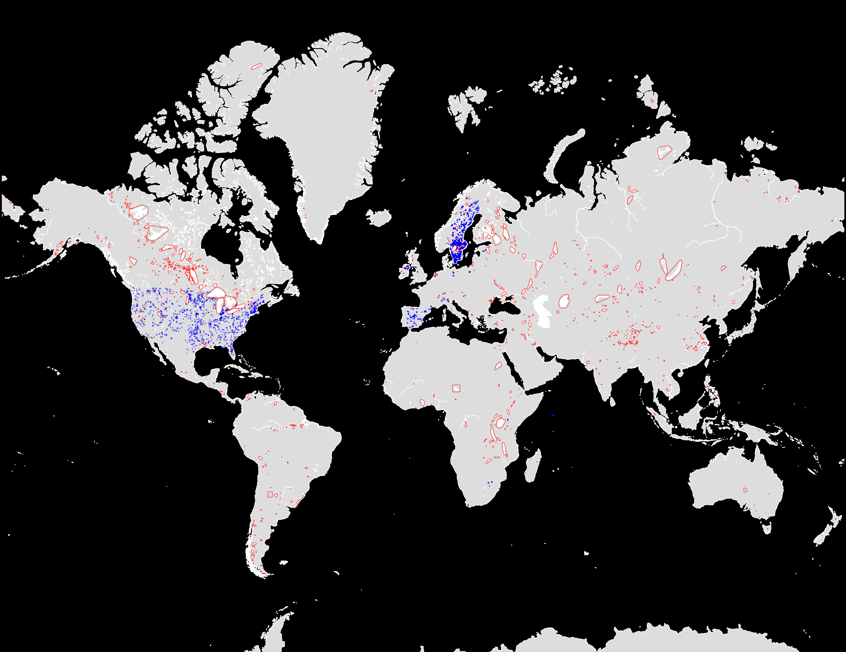
Next Steps
MERIS Match-Up and Validation
To apply the same approach
to MERIS Match up:
1. Test Atmospheric Correction
  Scape_M
  Megs
  Coast_Colour Processor
  Boreal Lakes Processor
  Eutrophic Lakes Processor
  FUB-WeW-Water Processor
2. Apply the same cluster classification and algorithm approach
3. Test more algorithms not included
FUB, Boreal Lakes , CC
Data for 1500 lakes, 600,000 match ups (with Chl a)
Sentinel 2/3 validation
Match up with 2016 and 2017 overpasses
Calimnos Processing Chain
Brockmann, PML and Stirling
First version of 1000 lakes produced
IOCCG-21 Committee Meeting

Slide 22
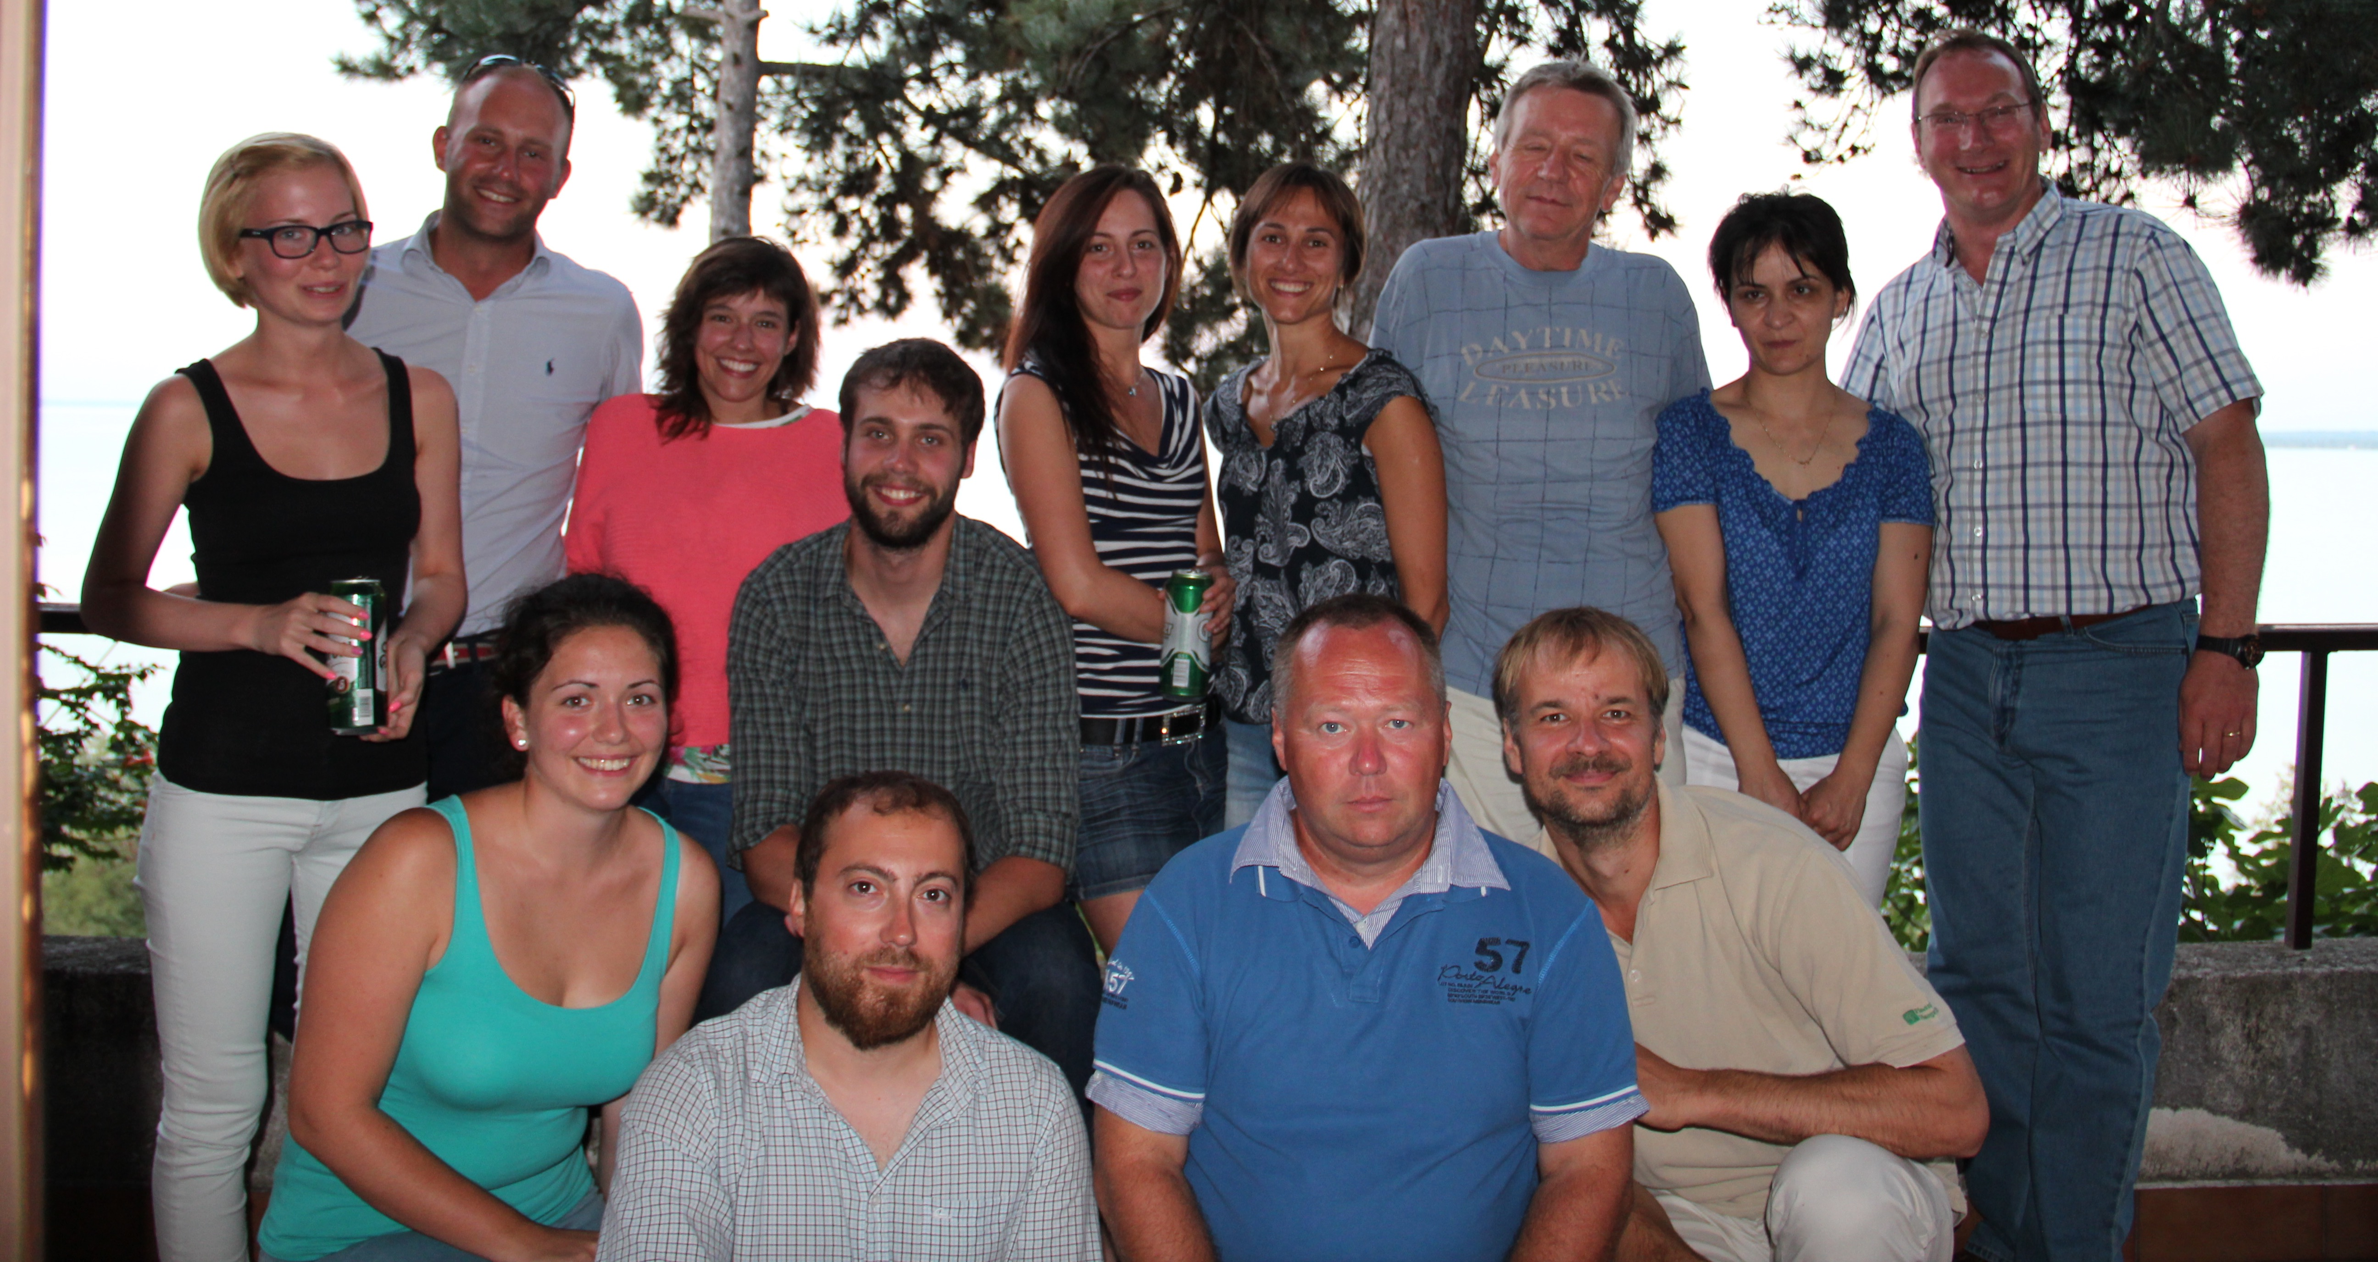
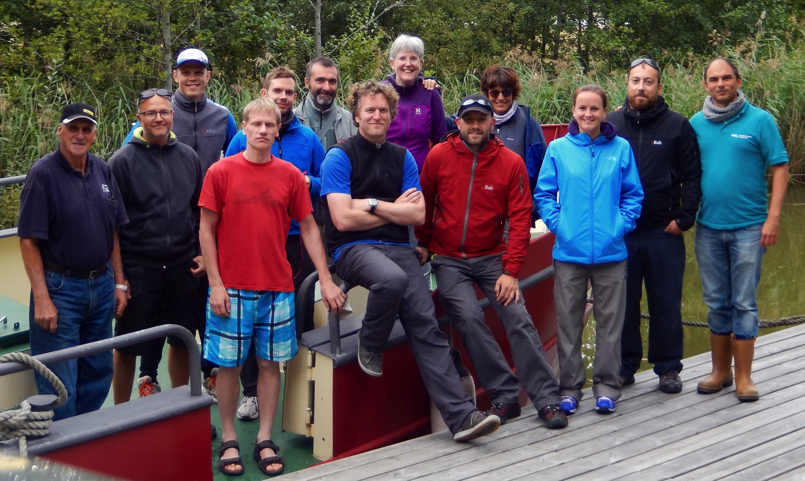
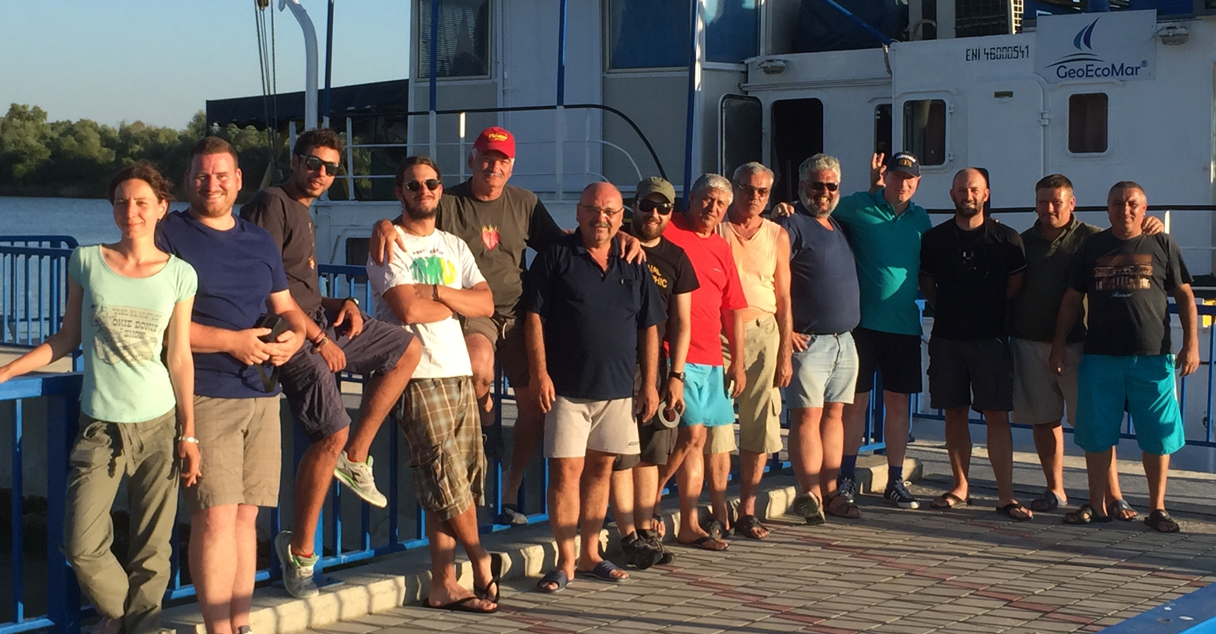
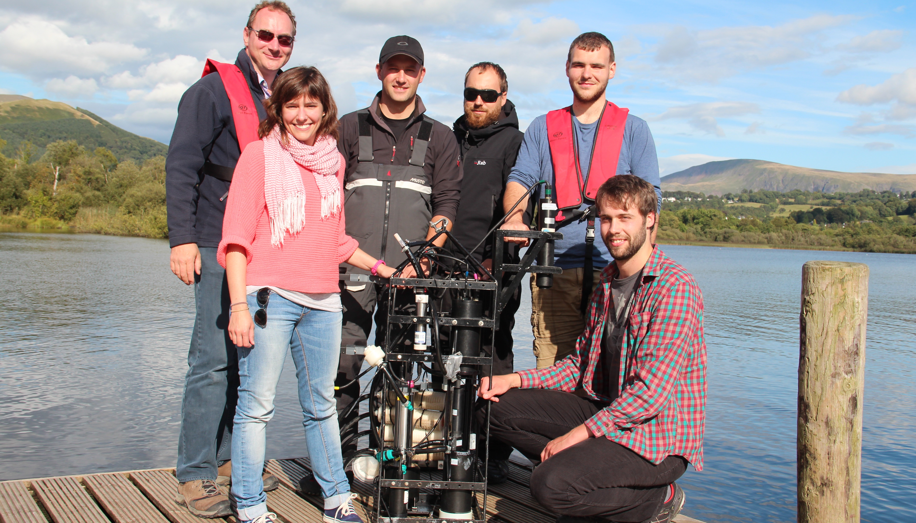
Conclusions
Band ratio 708/665 is the optimal independent variable for describing Chla.
Gurlin 2011¹ band ratio algorithm produced the most accurate results when considering the full LIMNADES dataset, closely followed by Gons 2005², Gilerson 2010³, NCDI 2012⁴ and QAA 2013⁵.
Estimations of Chla can be improved by reparametrising the simple 708/665 band ratio algorithm for each cluster.
Further improvement can be made by dynamically applying the best performing algorithm per cluster.
The dynamic approach estimates Chla with a mean absolute percentage difference of 21 %.
More results to follow…..
Lake Balaton
Lake Geneva
Lale Varnen
Danube Delta
English Lake District
IOCCG-21 Committee Meeting

Slide 23
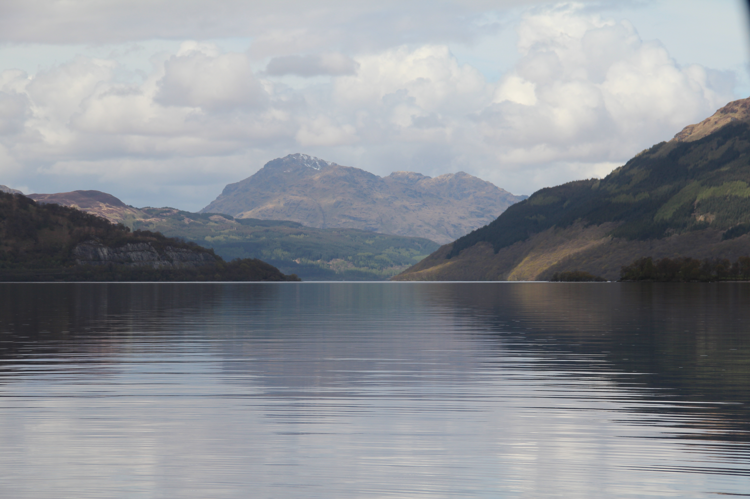

Joint GLaSS-GloboLakes 2016
Workshop
Thank you
2012-15
ESA
ARC-Lakes
(Reading)
WP1: EO algorithms for lakes (Stirling)
ESA DIVERSITY II
(Brockman Consult)
EO model development and processing
EU FP7 INFORM
WP2: Operational NRT processing (PML)
WP3: Climate and catchment data (Dundee)
2013-17
WP4: Data integration and uncertainty assessment (Stirling/Glasgow)
Quality assurance
2013-15
Advisory Panel
Test Data
WP5: Spatial and temporal patterns
(Glasgow)
Data analysis and interpretation
Andrew Tyler
Professor of Environmental Monitoring
Biological and Environmental Sciences
University of Stirling
    t +44 1786 467838
    e a.n.tyler@stir.ac.uk
    w www.stir.ac.uk
2014-16
WP7: Forecasting models (CEH)
WP6: Attributing causes (CEH)
2012-17
WP8: End-user applications for lake management (Stirling – All)
End-user
engagement
www.globolakes.ac.uk
follow @globolakes
IOCCG-21 Committee Meeting
Notes:
Good morning,
I would like to thank very much the organisers for inviting my group to give this talk in this influential event. And pass Andrew’s apologies for not being able to attend.
I want to use these 10 minutes to scratch actually the surface on EO uses and challenges for inland water quality giving a perspective of GloboLakes project and hopefully raise some discussion points.
GloboLakes is short for Global Observatory of Lake responses to Environmental Change and one of it’s aims to to develop an operational system for remote sensing of lakes. GloboLakes is a 5-year project wholly funded by the UK’s Natural Environment Research Council. It’s a consortium of researchers from 6 different UK university and research institutes and includes not only EO scientists – but also lake ecologists, ecosystem modellers and statisticians

Slide 24
Clustering of algorithm groups
2012-15
ESA
ARC-Lakes
(Reading)
WP1: EO algorithms for lakes (Stirling)
ESA DIVERSITY II
(Brockman Consult)
EO model development and processing
EU FP7 INFORM
WP2: Operational NRT processing (PML)
WP3: Climate and catchment data (Dundee)
2013-17
WP4: Data integration and uncertainty assessment (Stirling/Glasgow)
Quality assurance
2013-15
Advisory Panel
Test Data
WP5: Spatial and temporal patterns
(Glasgow)
Data analysis and interpretation
2014-16
WP7: Forecasting models (CEH)
WP6: Attributing causes (CEH)
2012-17
WP8: End-user applications for lake management (Stirling – All)
End-user
engagement
IOCCG-21 Committee Meeting
Notes:
Good morning,
I would like to thank very much the organisers for inviting my group to give this talk in this influential event. And pass Andrew’s apologies for not being able to attend.
I want to use these 10 minutes to scratch actually the surface on EO uses and challenges for inland water quality giving a perspective of GloboLakes project and hopefully raise some discussion points.
GloboLakes is short for Global Observatory of Lake responses to Environmental Change and one of it’s aims to to develop an operational system for remote sensing of lakes. GloboLakes is a 5-year project wholly funded by the UK’s Natural Environment Research Council. It’s a consortium of researchers from 6 different UK university and research institutes and includes not only EO scientists – but also lake ecologists, ecosystem modellers and statisticians

Slide 25
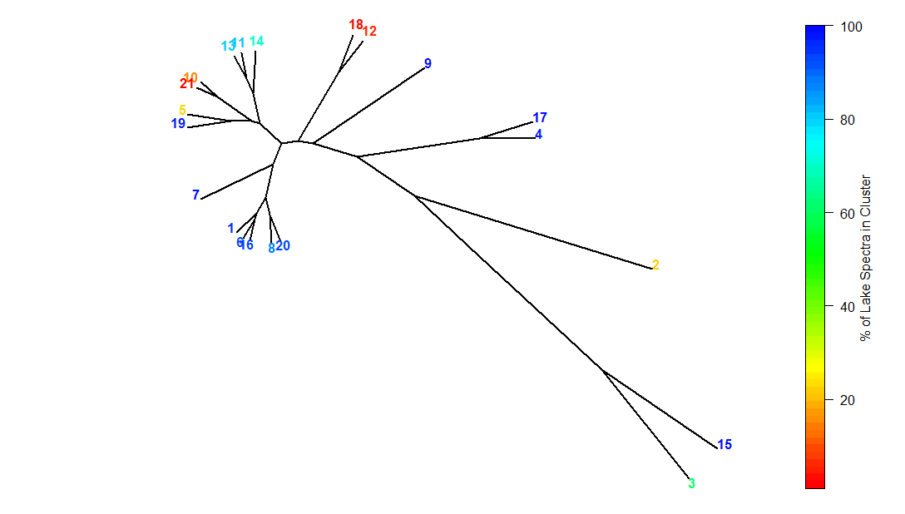
Clustering of algorithm groups
Clusters comparison
IOCCG-21 Committee Meeting

Slide 26
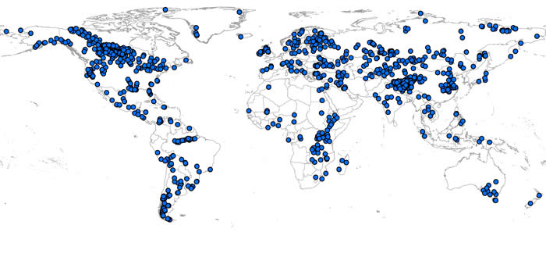
The Challenge
What is the global variability in OWT?
High diversity in lake optical properties…but variability poorly understood;
Need approach for dynamic selection of in-water algorithms or derived products;
In-water models not tested robustly over full spectrum of lake water optical types.
IOCCG-21 Committee Meeting

Slide 27
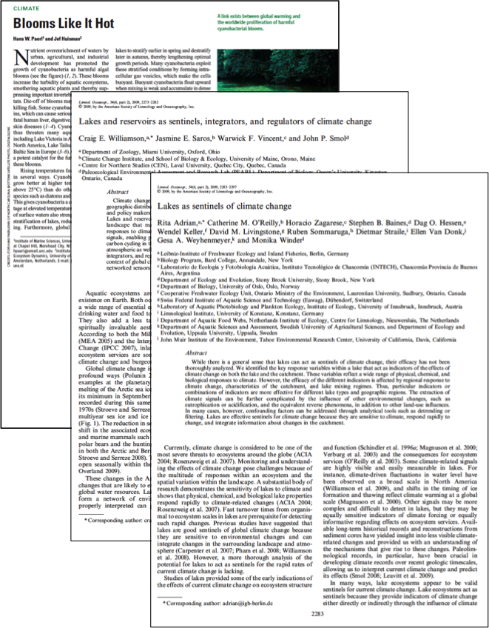
Project Aims
GloboLakes will investigate the global status of lakes and their responses to environmental change
Lakes are sensitive sentinels of change
Responses of individual lakes or populations of lakes vary in time and space
What controls the differential sensitivity of lakes to environmental change?
IOCCG-21 Committee Meeting
Notes:
Good morning,
I would like to thank very much the organisers for inviting my group to give this talk in this influential event. And pass Andrew’s apologies for not being able to attend.
I want to use these 10 minutes to scratch actually the surface on EO uses and challenges for inland water quality giving a perspective of GloboLakes project and hopefully raise some discussion points.
GloboLakes is short for Global Observatory of Lake responses to Environmental Change and one of it’s aims to to develop an operational system for remote sensing of lakes. GloboLakes is a 5-year project wholly funded by the UK’s Natural Environment Research Council. It’s a consortium of researchers from 6 different UK university and research institutes and includes not only EO scientists – but also lake ecologists, ecosystem modellers and statisticians

